Slide 1
Flare towers
Nidhi Kulkarni 22CHE142
Arya Dahake 20CHE113

Slide 2
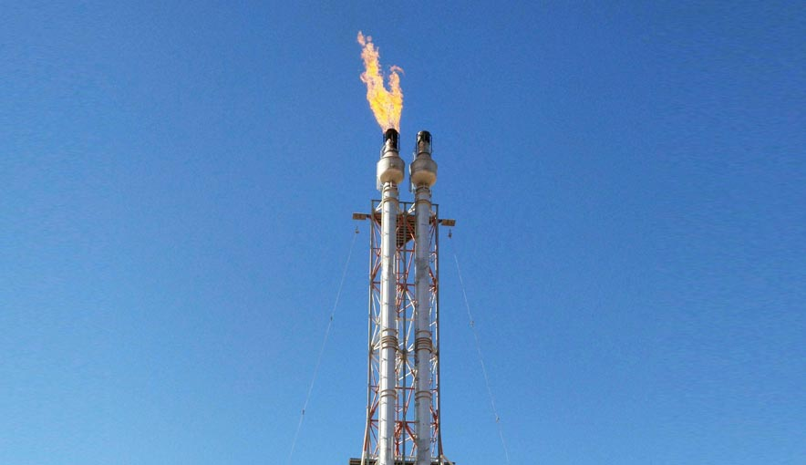

Slide 3
01
03
Header
Liquid seal
02
04
Flash Knockout drum
Flare stack

Slide 4
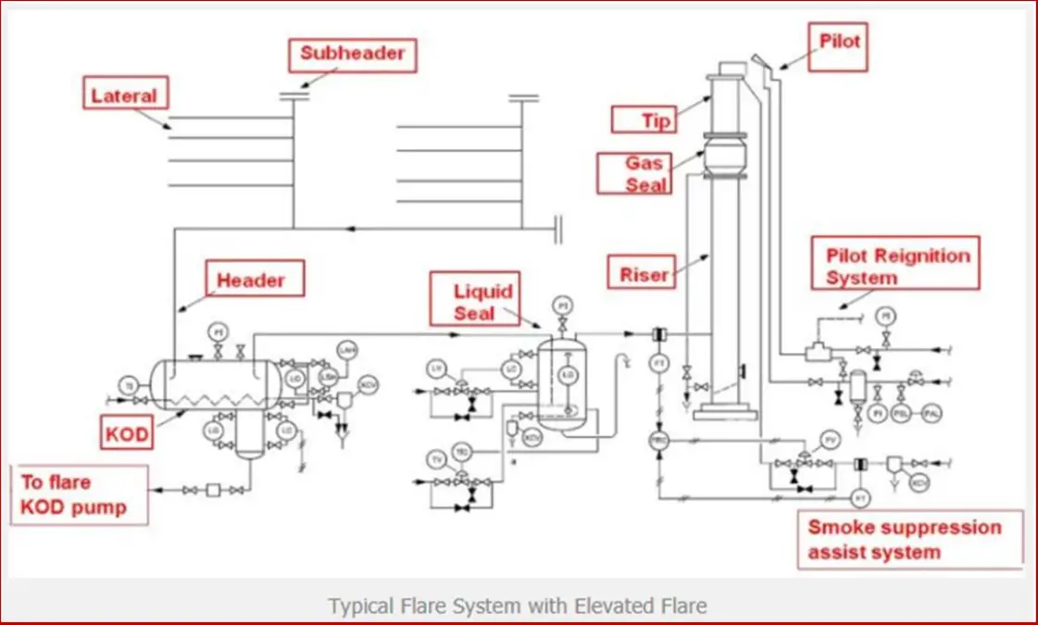

Slide 5
Liquid seal
prevents air ingression during sudden temp changes
to prevent flash back from flare tip to headers
maintained above the inlet of the flare system
prevents returning from outlet to inlet of the drum
divisional unit for flares

Slide 6
Gas seal
Velocity Seal (gas seal)
• The velocity seal work works on the premise that when air infiltrates the flare tip, it tends to hug the inner walls of the flare tip
• The velocity seal is a cone-shaped obstruction placed inside the flare tip so as to obstruct the infiltrating air from ‘hugging the inner wall’
• Purge gas coming through the cone sweeps away the infiltrating air. This seal normally reduces the purge gas velocity through the tip to between 0.006 m/s to 0.012 m/s and maintains the oxygen level below the seal under 4-8% level
• However the normal purge gas requirement to prevent burn back of the flare tip is much higher than this.

Slide 7
FLARE DRUM SIZING
- API rp 521
- stokes droplet size of 500-600 mm
- 20-30 minutes of holdup time
- no internals to facilitate separation and eliminate potential blockages
- many orientations and options(horizontal and vertical)
- liq removed by flare pumps

Slide 8
Re-ignition system
Flaring is used to safely burn off excess or unwanted flammable gases in refineries, chemical plants, and oil & gas facilities. If the flame goes out, unburned gases (like methane, propane, or H₂S) can escape into the atmosphere
The reignition system is a safety mechanism designed to ensure that the flare flame remains lit, even if it gets extinguished due to sudden changes in gas flow, weather conditions (like strong winds or rain), or operational issues.

Slide 9

Environmental concerns
Complete combustion
CO2 release
Height of flare tower

